Slide 1
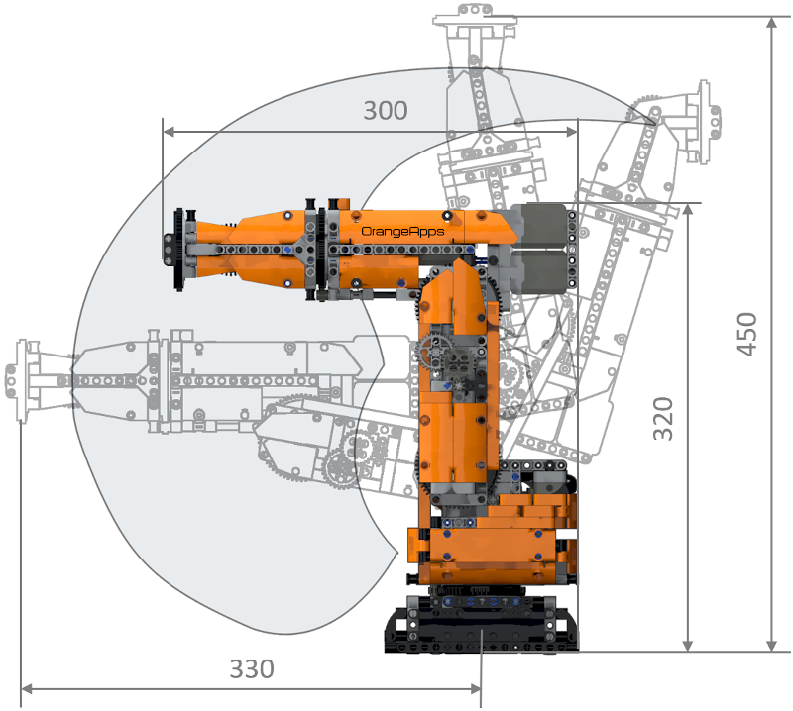
Introduction
Each robotic arm is designed and manufactured by considering several key parameters, including the number of axes and corresponding degrees of freedom, the working envelope and the area the robot covers, payload, speed and acceleration, repeatability etc.
The KUKA Lego robot is a scaled down poly-articulated type robotic arm with 6 axes.
Fig. KUKA Lego robot
Key Terminologies
Degree of Freedom – The number of independent motions of a robot.
Tool Reference Frame (TRF) – The coordinate system fixed with the robot’s end effector.
Tool Center Point (TCP) – The point of the tool where the action is performed.
Specifications:
Degrees of freedom : 6
Controller : built-in LEGO® SPIKE™ controller
Reach : approx.. 330 mm

Slide 2
Robot Programming Methods
There are two main programming methods, namely online programming and offline programming.
Online Programming
Teach pendant programming
A teach pendant (SmartPAD) is utilized to guide the robot to the desired coordinate or positions.
Lead-through programming
It is very similar to teach pendant, but here the robot is physically guided to the desired position.
Offline Programming
KRL programming
KUKA Robot Language (KRL) is a textual, structured programming language used to program robots.
Simulation Software
Simulation software can be used to design, test and optimize robot program in a 3D virtual environment.

Slide 3
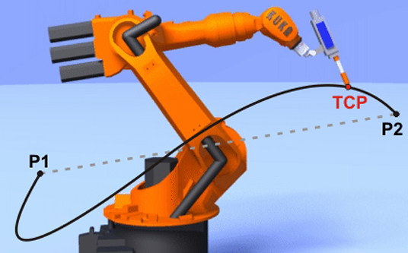
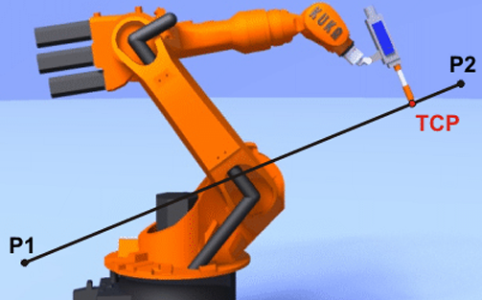
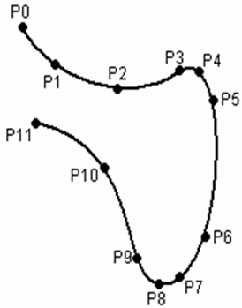
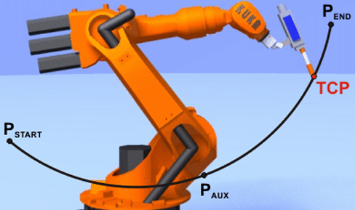
Types of Motion
PTP (Point-to-point) motions
The robot guides the TCP from one point to another along the fastest path.
LIN (Linear) motions
The robot moves the TCP along a straight line at a defined velocity from one point to another.
CIRC (Circular) motions
The robot moves along a circular path from one point to another.
SPLINE motions
The robot moves through multiple points describing a smooth curve.
Fig. PTP motion
Fig. LIN motion
Fig. CIRC motion
Fig. SPLINE motion

Slide 4
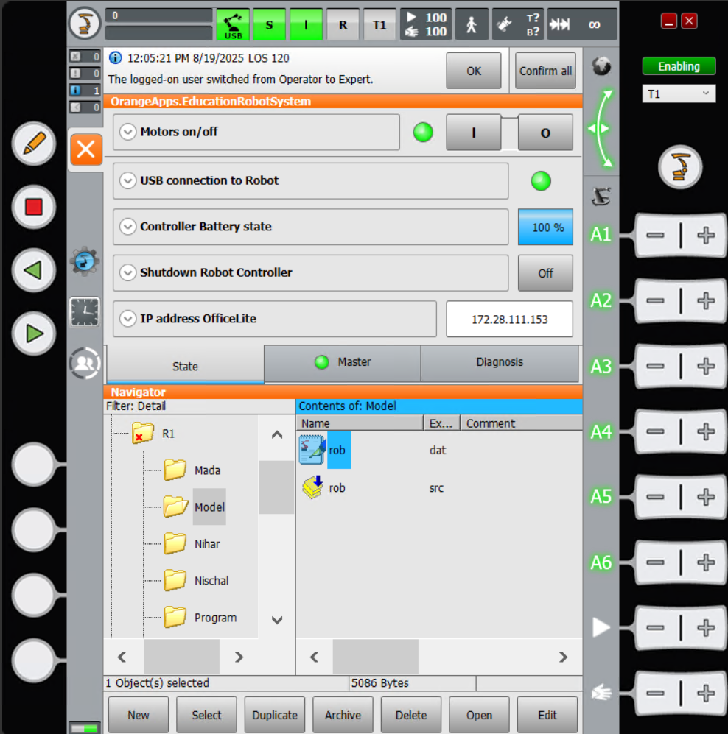
KUKA SmartHMI User Interface
Function: The KUKA SmartHMI has all the control and display functions required to operate and program the robot
1
2
3
4
14
5
15
6
12
16
11
17
13
7
8
9
10
Fig. KUKA SmartHMI User Interface

Slide 5
Sl.No | Description
1 | Status Bar
2 | Message Counter- displays how many of each message types are active
3 | Message window- All the active messages can be expanded by touching the message window.
4 | Space Mouse status indicator - The current coordinate system which is used as reference for jogging. By default, it is set to world
5 | Space Mouse alignment indicator- displays the current alignment of the Space Mouse, which can be modified
6 | Jog Keys status indicator- the current coordinate system for jogging
7 | Jog Key labels – for axis specific jogging (from A1 to A6)
8 | Program override
9 | Jog override
10 | Button bar – the activation of these buttons depends on the current active window in the SmartHMI.
11 | Clock- the clock displays the system time
12 13 14 15 16 17 | Work Visual icon- to access the Project management window Configuration- to set the user group. Keyboard key- to display the keyboard. Stop key- to stop the program Start backwards key- to start the program backwards. Start Key- to start the program.

Slide 6
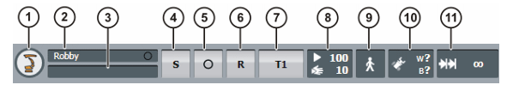
Status Bar – The status bar displays the status or modes of various critical settings of the robot.
Fig. Status bar of KUKA SmartHMI
Sl.No | Description
1 | Main menu key
2 | Robot name
3 | Program name – the name of the selected program is displayed here.
4 | Submit interpreter status indicator
5 | Drive status indicator- displays the mode of the drives, either Switched on or off (the symbol O for OFF and I for ON).
6 | Robot interpreter status indicator- indicates whether the program is selected, executing or stopped
7 | Current Operating mode – usually T1 for testing and teaching operations
8 | POV/HOV status indicator- indicates the current program override and the current jog override
9 | Program run mode status indicator- indicates the current program run mode
10 | Tool/Base status indicator
11 | Incremental jogging status indicator

Slide 7
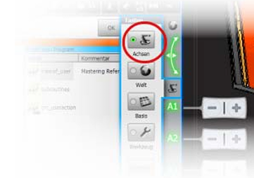
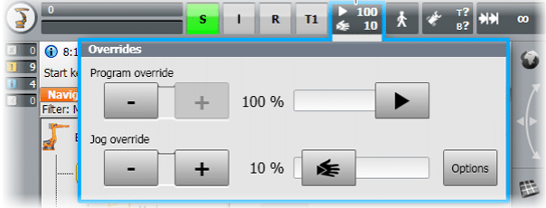
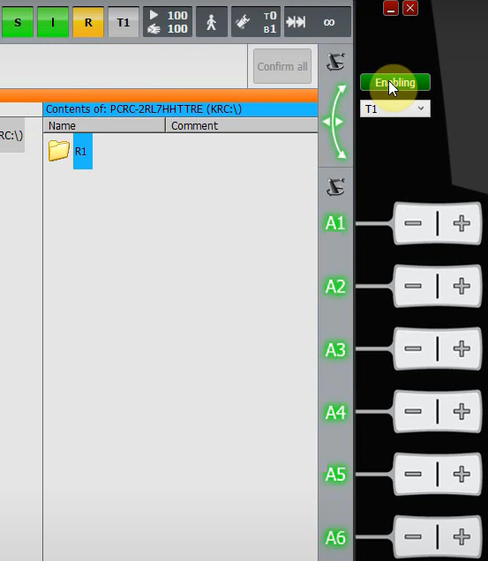
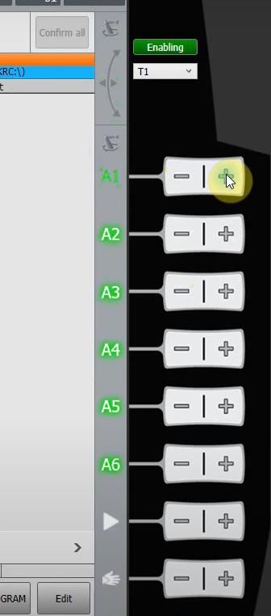
Jogging the robot
In axis specific jogging, each axis of the robot can be moved in the positive and negative direction using the jog keys.
Precondition
The Operating mode is set to T1.
Drives are switched ON.
(1)
(2)
Procedure
Select axes as the coordinate system for the jog keys
Set Jog override (specified in percentage of the velocity of robot during jogging)
Select the enabling switch, and thus the jog key axes A1 to A6 are highlighted.
Press + or – joy keys to move respective axes in the positive and negative direction.
(3)
(4)
Fig. Jogging the robot

Slide 8
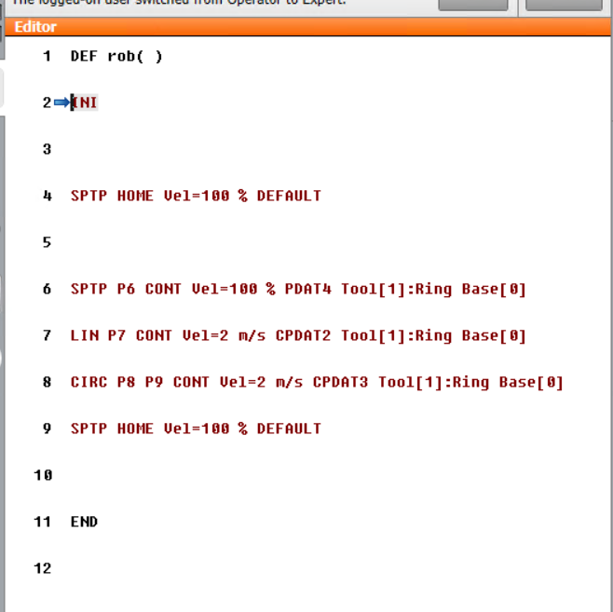
Sample KRL Code
Open the .Src file to write the program code.
Line No. | Description
1 | The DEF line specifies the name of the program. The line can also be hidden.
2 | The INI is the initialization line.
4 | HOME position command
6 | This line contains the Point-to-Point motion command.
7 8 | This line contains the Linear motion command. This line contains the Circular motion command.
9 | HOME position command
11 | The END is the last line of the program.
Fig. Sample Program code

Slide 9
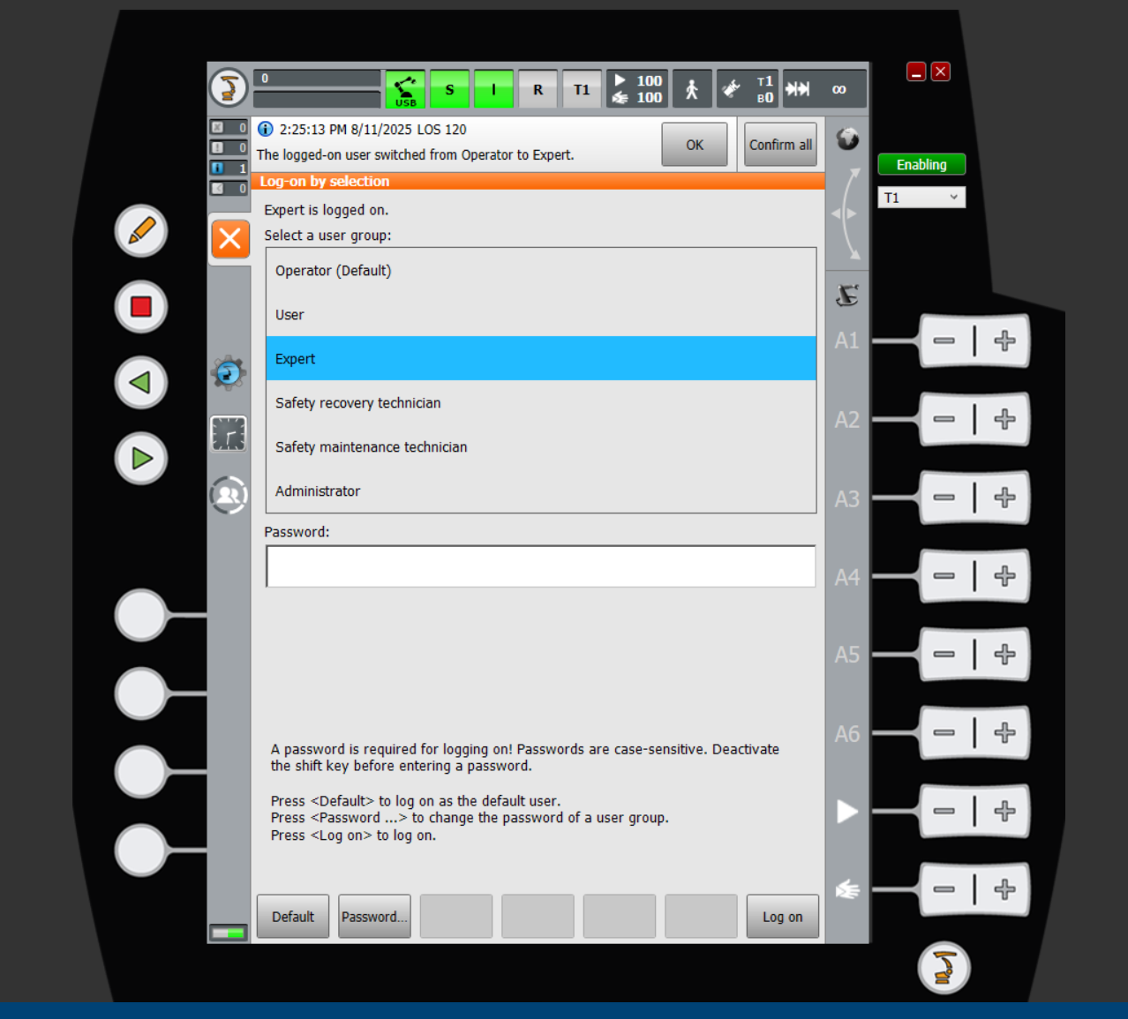
Set Expert Mode
The Kuka file types (.Dat file and .Src file) can only be accessed through the Expert user group.
In the user selection panel select expert mode.
Password – kuka

Slide 10
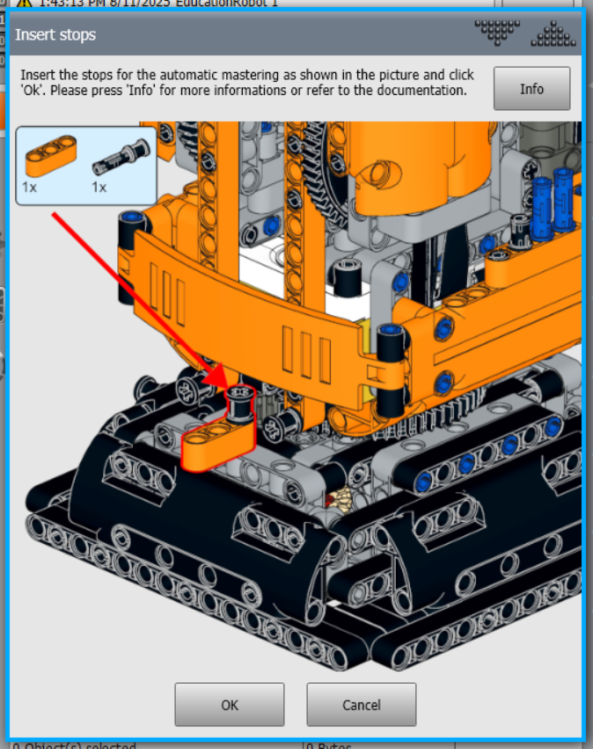
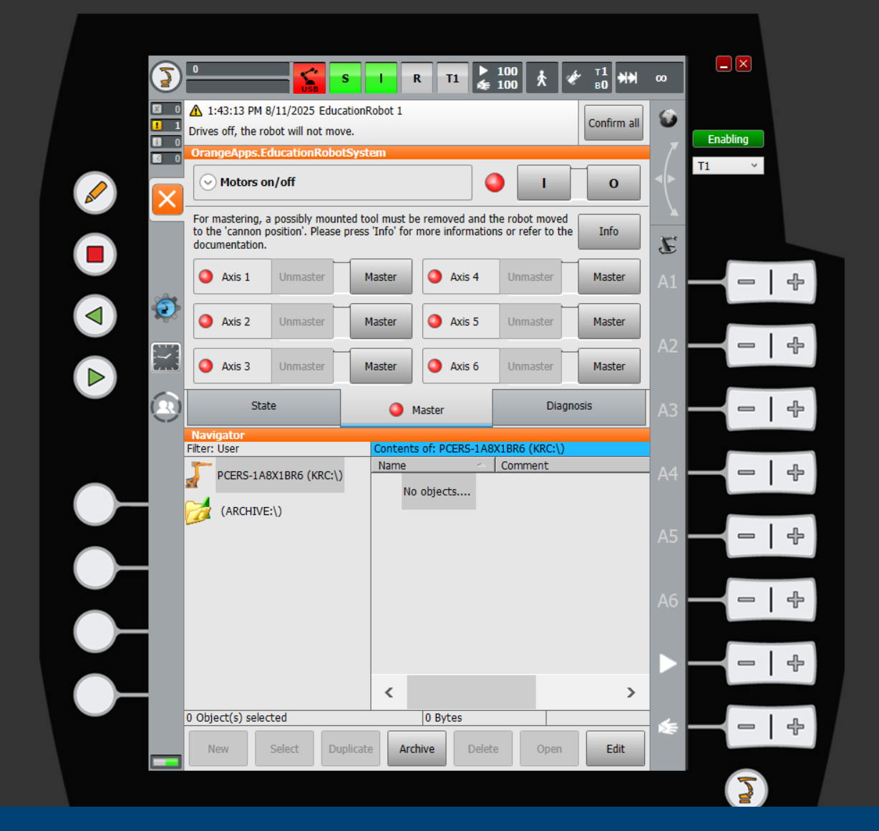
Master the Robot
Each axis has to be mastered individually before proceeding with the pick and place task.
Click the robot icon and select the master tab.
Select axis 1 and follow the on screen instructions to master it.
Continue with the other axes till all are mastered
Unmastered axis

Slide 11
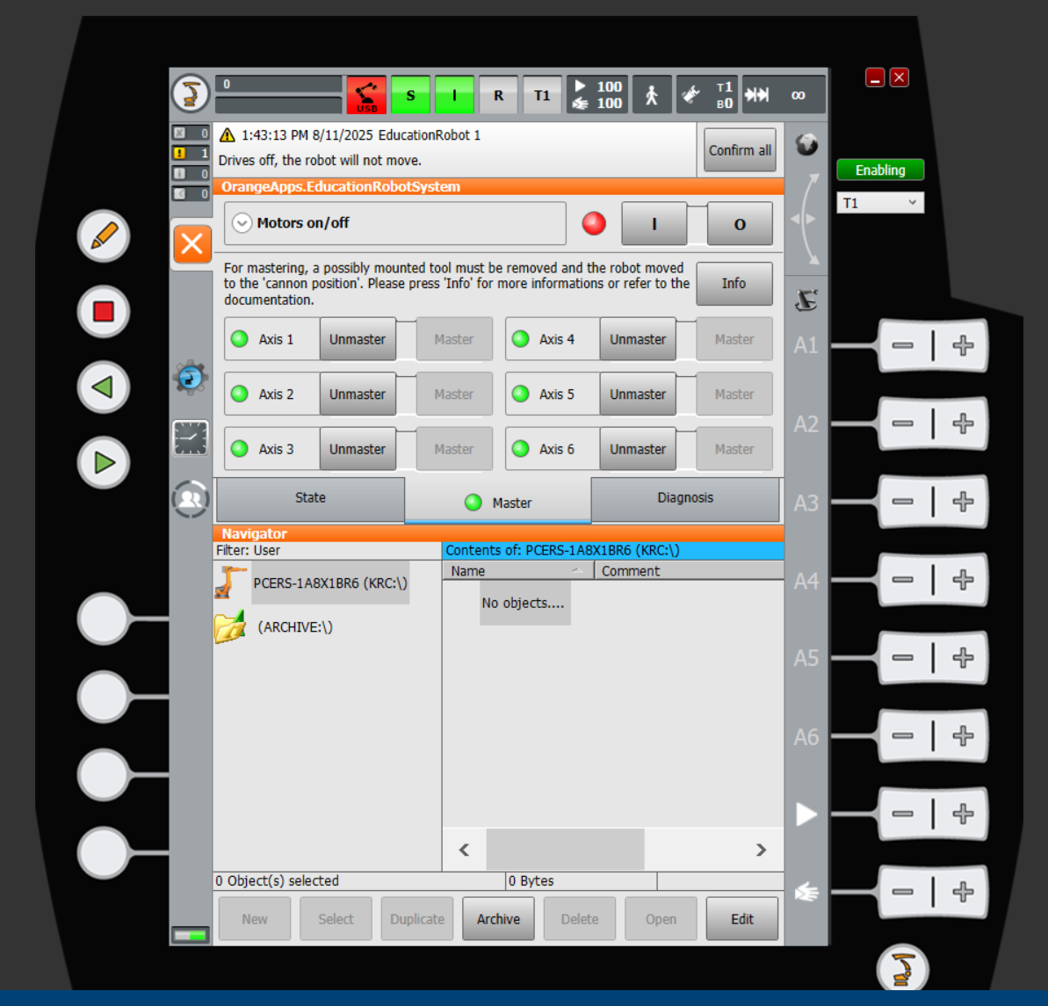
Mastered axis
Once mastered, the red indicator turns to green. When all the axes are indicated green you can proceed with the task.

Slide 12
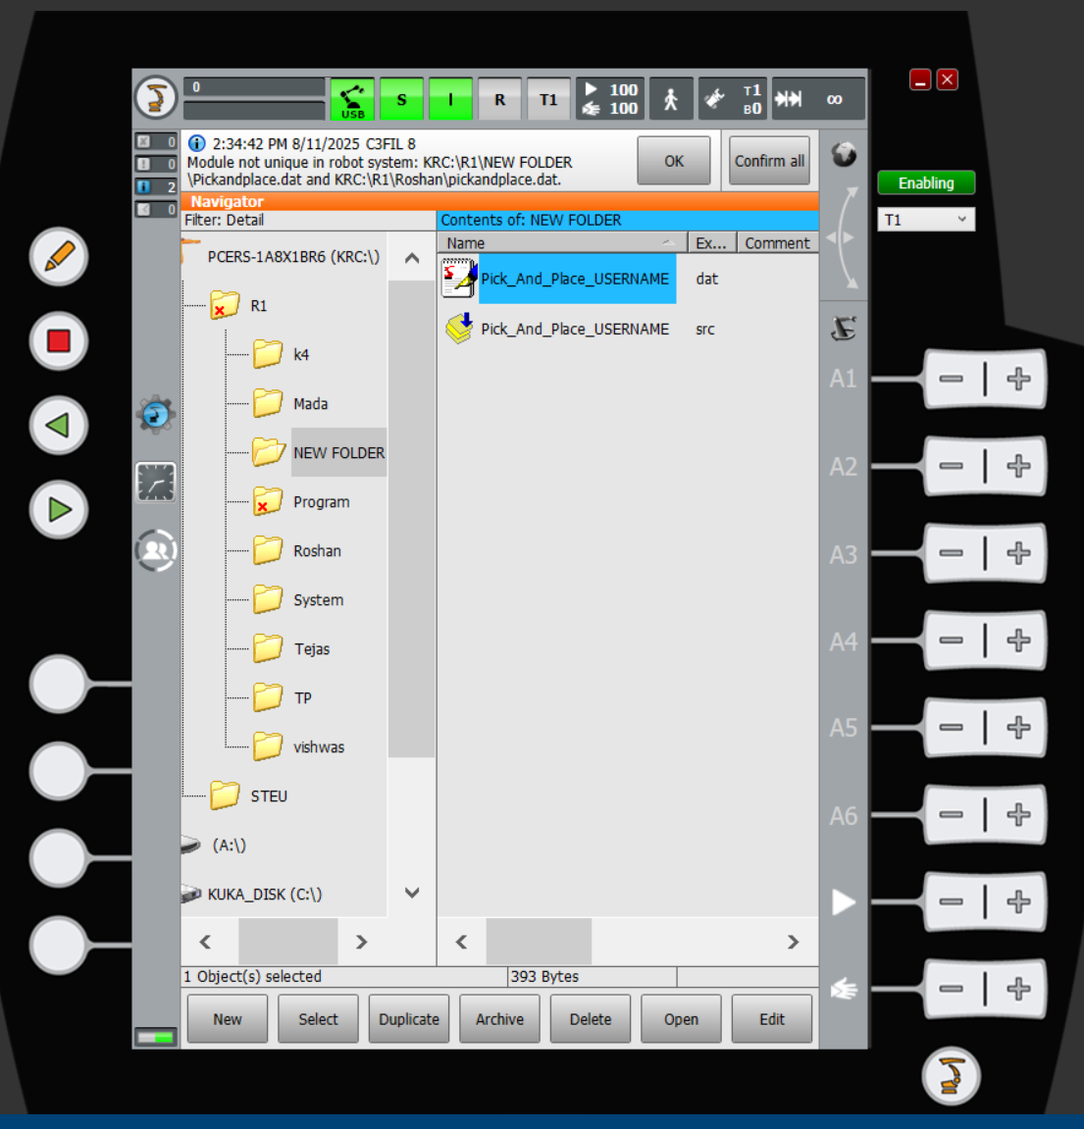
How to create a .src file
Switch to expert mode.
In the navigator menu, ensure that the specified folder is selected and the cursor is on the right half of the menu.
Click New>Module>Enter file name.
A new .src file and the corresponding .dat file are created.
Click the select option to open and edit the program.
Cursor in the right window

Slide 13
Description of the task
The primary objective of the task is to pick the work piece (Ping Pong ball) from the fixed pick up position, traverse over or around the obstacle and place it at the designated position.
The TCP has to follow the positions indicated in the diagram.
The coordinates of the said points and the type of motion can be chosen by the user.
Steps:
Ensure that the robot is mastered and at home position.
Place the work piece on the pick position.
The TCP moves from home position(H) to target position 1, then down to the pick position.
Once the work piece is secure in the gripper, the TCP moves to the target position 2 avoiding the obstacle.
The work piece is placed at the place position. The TCP returns to home position. This completes one work cycle.

Slide 14
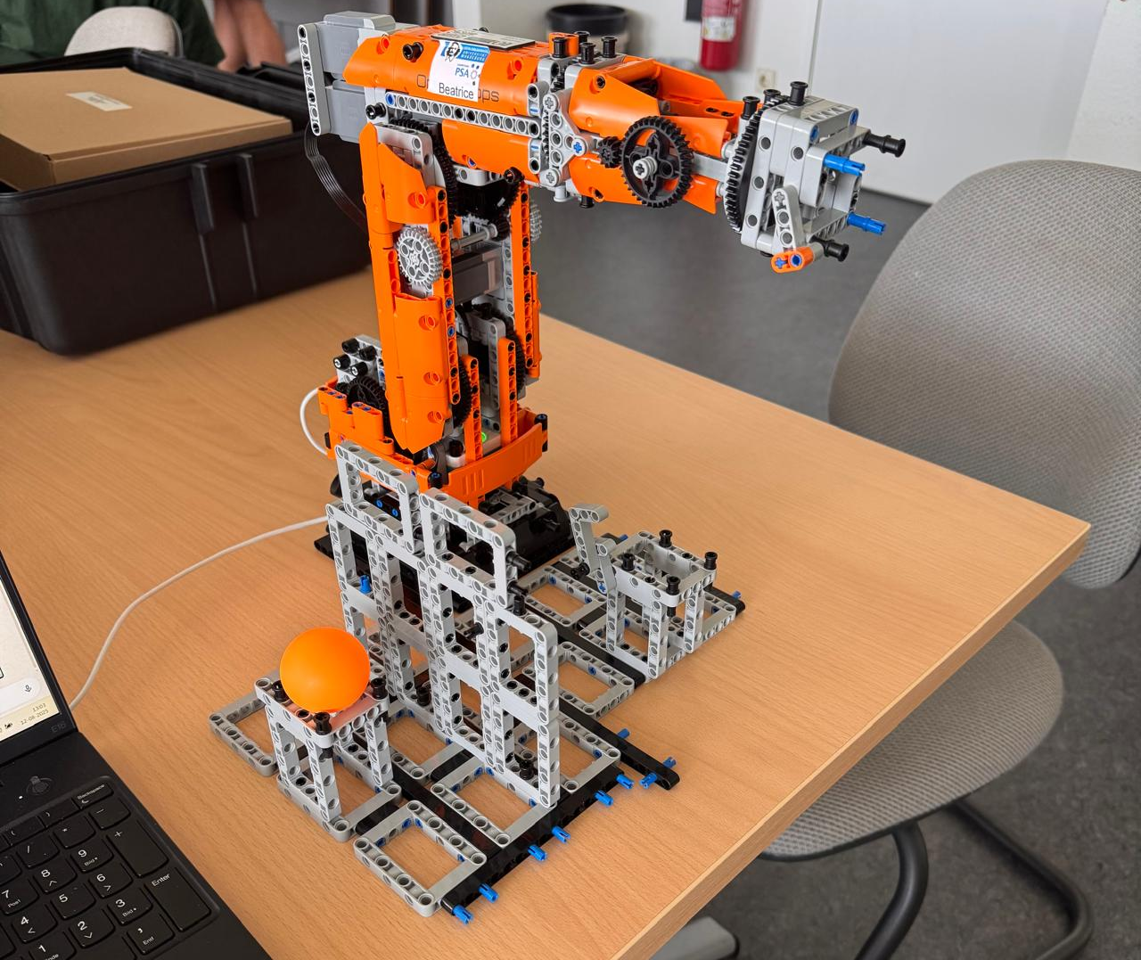
FRONT VIEW
Pick and Place Operation using KUKA robot
H
1
4
7
H
TCP Home
T
TCP Target Position 1
T
T
PI
TCP Pick position
2
3
5
6
T
TCP Target Position 2
PI
PL
PL
TCP Place Position
W
Work Piece
Work Piece Pick Position
TOP VIEW
Work Piece Place Position
Obstacle
KUKA ERS 3.0
W
Work Table
H
PI
PL
4

Slide 15
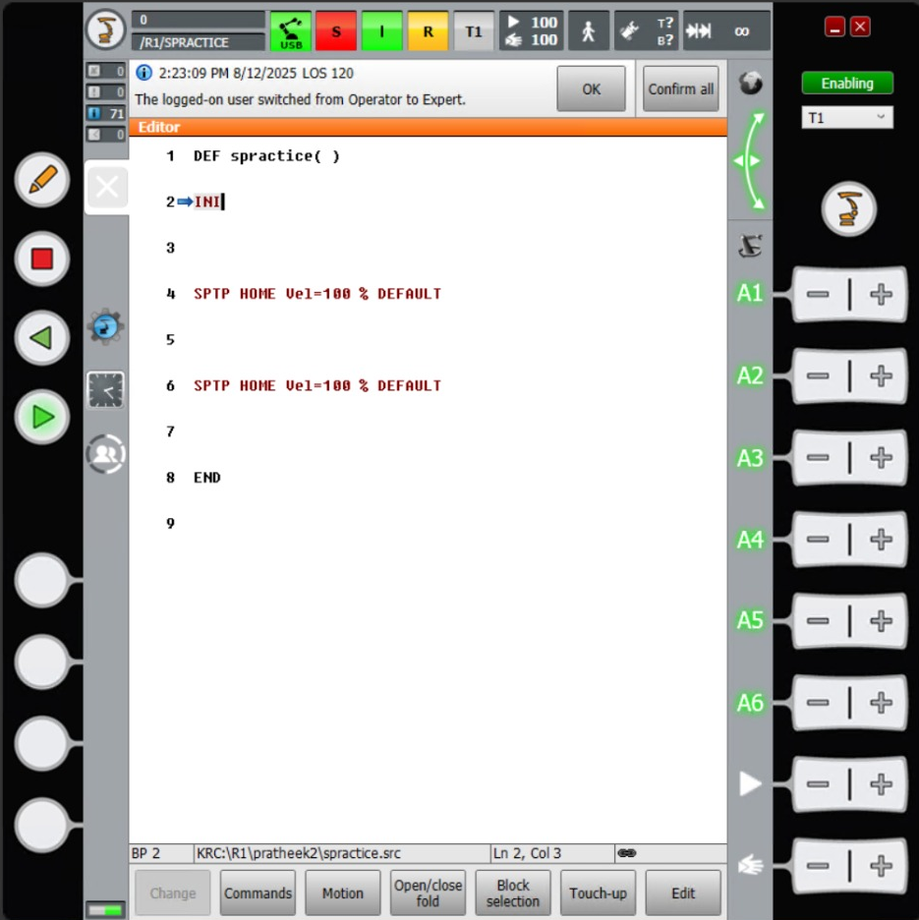
To cancel and reset the program
Commands to play, reverse and stop the program
Used to create movement around the axes of the robot
To create a point and define the movement
To define the position of the created point

Slide 16
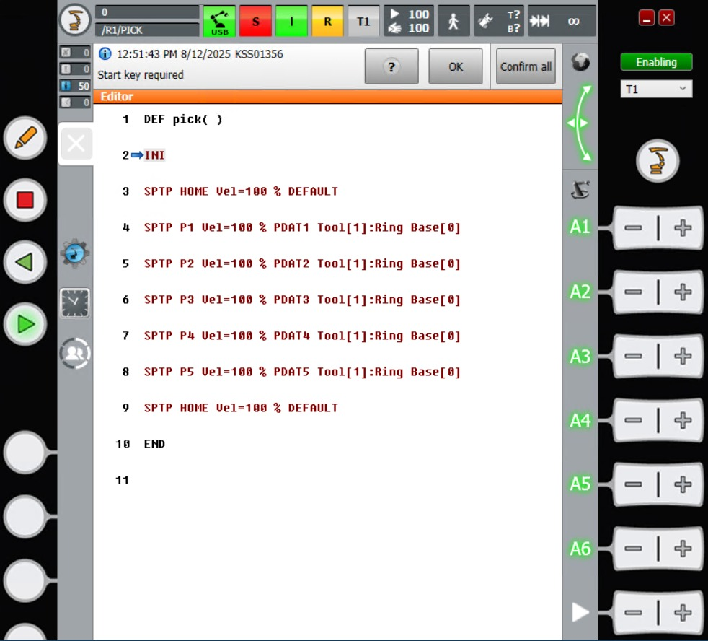
Set Target Position
Home Position
Home to Position 1
Position 1 to Position 2 (Picking Position)
Position 2 to Position 3
Position 3 to Position 4
Position 4 to Position 5 (Placing Point)
Position 5 to Home

Slide 17
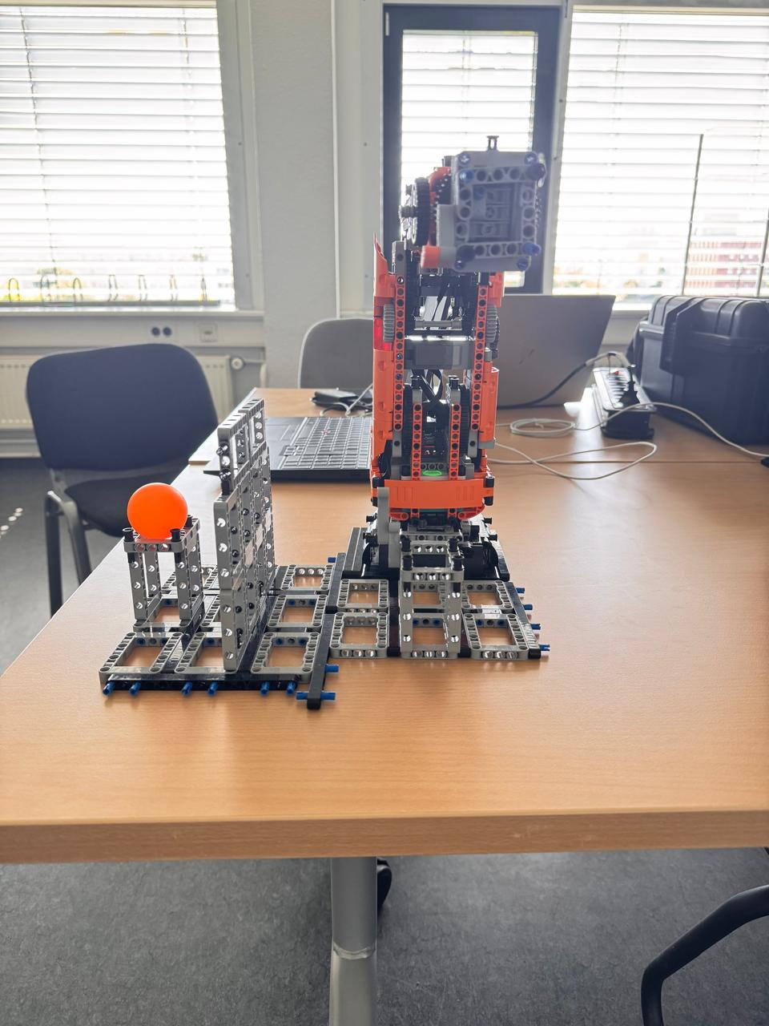
Home
T
T
PI
PL

